Slide 1

Moneyball…Again?
Alex Martishius
October 20, 2020

Slide 2
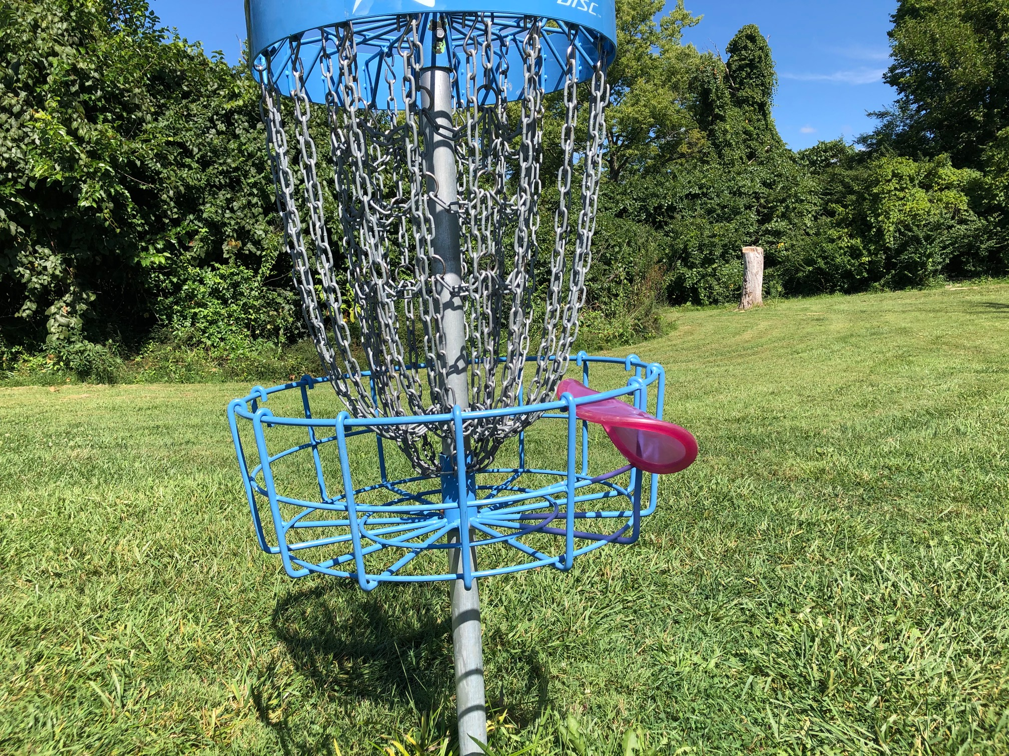
Alex Martishius
Current Title: Assistant Vice President and Quant Manager – Fifth Third Bank
Education: MS Statistics, Miami University, May 2014
BA Mathematics, Capital University, May 2012
Experience: Fifth Third Bank, Cincinnati OH (6.34 yrs)
Alex lives in Anderson Township, a suburb on the east side of Cincinnati Ohio. He is very fortunate to have a loving family which includes wife Janelle, daughter Winnie (4), son Wally (2), and another baby on the way! He enjoys spending time outside and is an avid Disc Golfer. He also enjoys playing and watching all sports.

Slide 3
Today’s Agenda
Intro to Baseball
What is “Moneyball”?
The Data
The Models
The Results
What was Good? What was Bad? What’s Left to Do?
Questions / Comments

Slide 4
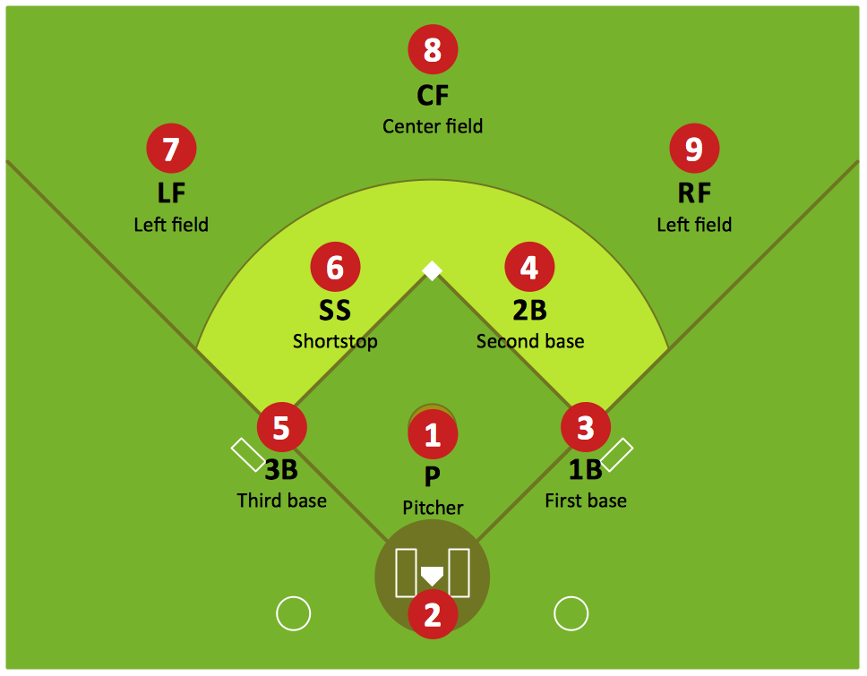
Intro to Baseball
Baseball is a popular American sport where teams of 9 try to score “runs” by traveling the perimeter of a diamond-shaped field with 4 bases.
The offense lines up in a sequence of 9 hitters, to be pitched to one at a time by the defense’s pitcher (#1). The pitcher tries to throw strikes past the hitter, while the hitter tries to hit the ball away from the defenders. If the pitcher gets 3 strikes past the hitter, he’s out. If the hitter gets the ball past the defenders, he’s got to travel the bases in order before the defenders bring the ball back in or else he’s out. 3 outs and the teams switch roles. If a runner makes it all the way around the perimeter back to home plate, he scores a run. Whoever has more runs after 9 innings (1 set of O&D for each team) wins the game.
There is a lot of advanced strategy required to win the game. If you have questions about baseball strategy, please ask!

Slide 5

Major League Baseball
30 Professional Baseball Teams around the U.S. playing 162 baseball games per season, starting in April and ending in October. The teams are split into “leagues” (2) and “divisions” (6) regionally, with each team trying to win their division. National League and American League have West, Central, and East divisions.
At the end of the season, 10 teams make the playoffs for a chance to win the World Series.
Playoff Ticket Revenue can reach the tens of millions for teams who make the playoffs, as can TV Revenue.

Slide 6
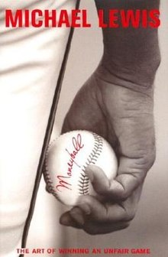
What is “Moneyball”?
“Moneyball” refers to strategies undertaken by team managers designed to sign cheap players who provide more value than what their salary would imply.
Why do we need Moneyball? Because there is no salary cap in the MLB, small-market teams must squeeze performance out of cheap players, or else they will have no chance to compete against big-market teams.
The term was coined by Michael Lewis in 2003 when he wrote the book on the subject. Within he describes the birth of advanced analytics in baseball. Billy Beane and Paul DePodesta of the Oakland As built regression models and determined that OBP and SLG were more indicative of value than the universal RBI and AVG.
Since the release of the book, advanced analytics has exploded in the MLB. In this project I attempted to again identify underpaid players based on a variety of advanced metrics.

Slide 7
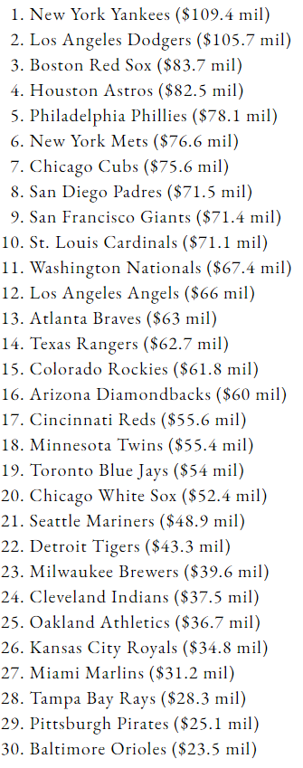
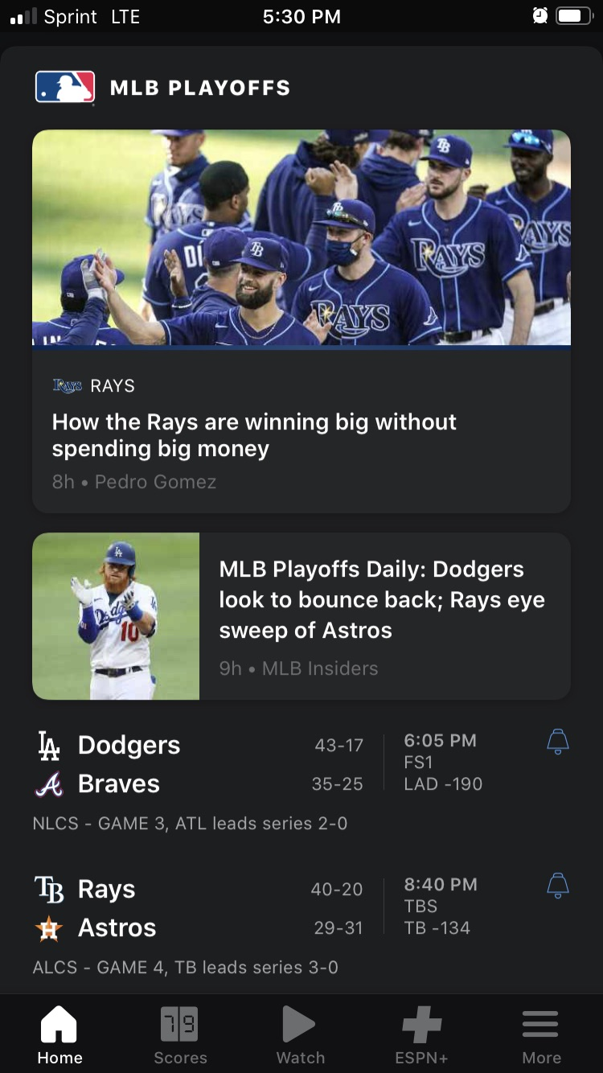
2020 Team Payrolls →
*Made NLCS
*Made ALCS
*Made NLCS
*Made ALCS

Slide 8
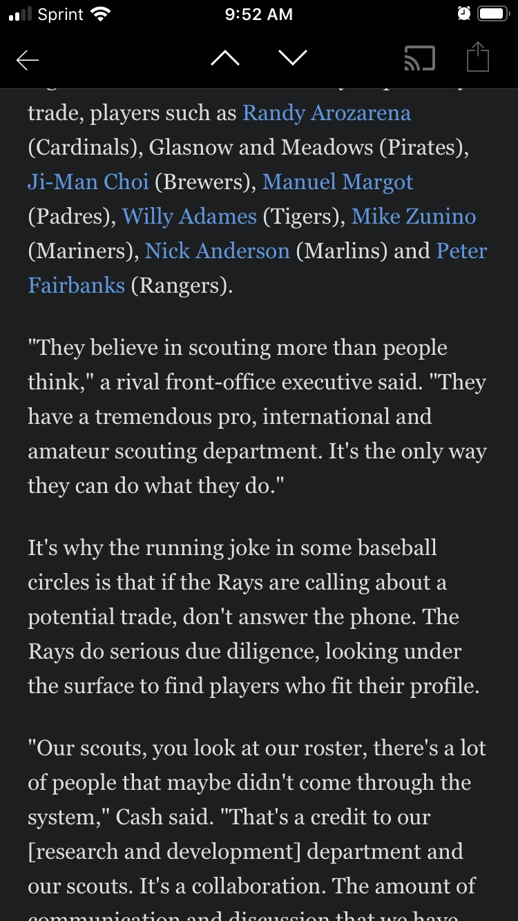
How Can Small Markets Compete?
The Tampa Bay Rays made the “final 4” teams in 2020 while having a total payroll less than half of each of the other 3 teams. How did they do this?
Simply put, they are loaded with players who are more valuable than their salary would indicate.
This can be achieved via “Draft&Farm” (payroll agnostic) or trade.
The purpose of this project is to attempt to identify players who could be traded for because they are more valuable than their salary would indicate. Let’s see what happens!

Slide 9
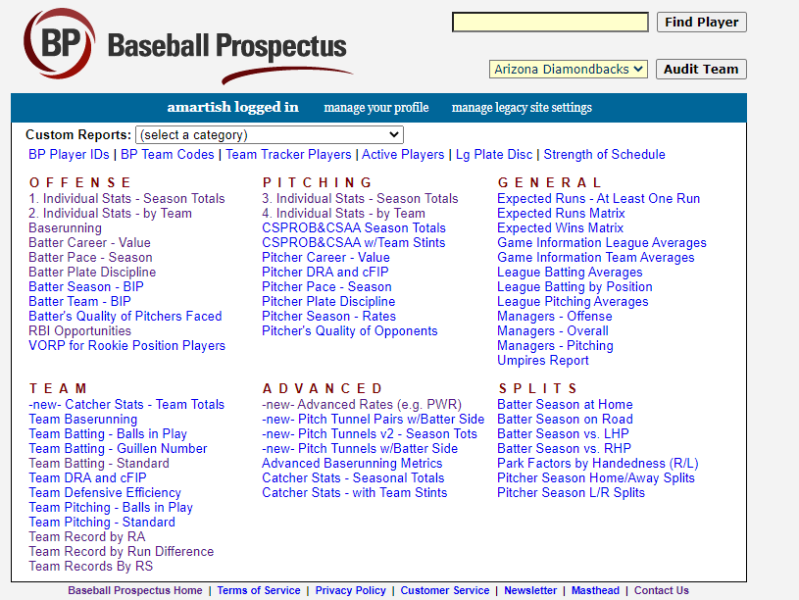
The Data
I went to www.baseballprospectus.com and downloaded Salary data from the years 2015-2019 for all MLB players.
I merged each year’s salaries with offensive statistics from 1 and 2 years prior. Theory: a 2015 player’s salary can be explained by his offensive stats from 2013 and 2014, 2016 salary is explained by 2014 and 2015 stats, etc.
The number of years of salary to include, as well as the number of lags to include is arbitrary. I wanted to keep the project manageable for a short timeline.
The final dataset contains only the perfect intersection of all data tables, with a few exclusions added (described later). In other words, data only made it into the final set if no features were missing from any tables.

Slide 10
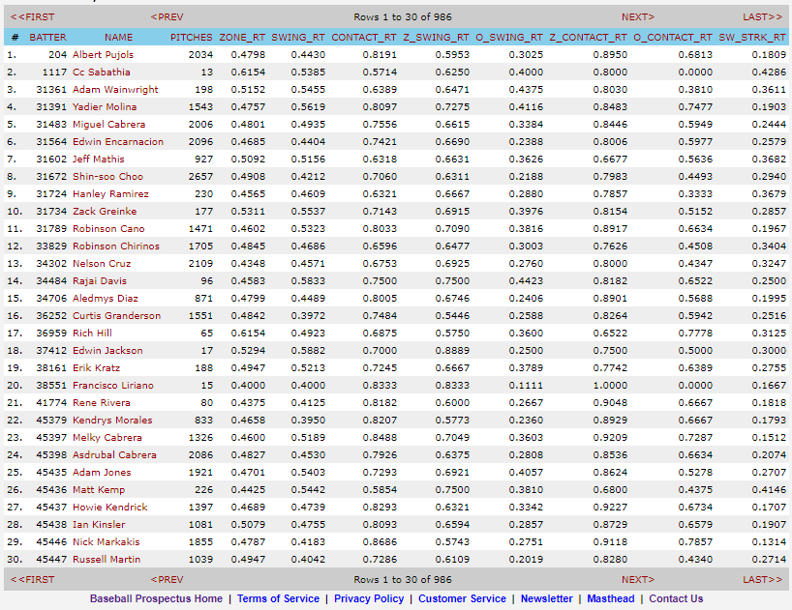
The Data (Tables)
The following Advanced Stats data tables were downloaded from www.baseballprospectus.com : Baserunning, Batter Pace, General Offensive Stats (such as AVG, RBI, OBP, SLG, OPS, etc), Plate Discipline, RBI Opportunities (Clutch), and DRC+ (Deserved Runs Created).
Each category above has a yearly table. Therefore the final modeling dataset was curated from:
Baserunning 2013-2018 (6 tables)
Batter Pace 2013-2018 (6 tables)
General Offensive 2013-2018 (6 tables)
Plate Discipline 2013-2018 (6 tables)
RBI Opportunities 2013-2018 (6 tables)
DRC+ 2013-2018 (6 tables)
Salary 2015-2019 (5 tables)
41 Total Tables Downloaded as CSV

Slide 11
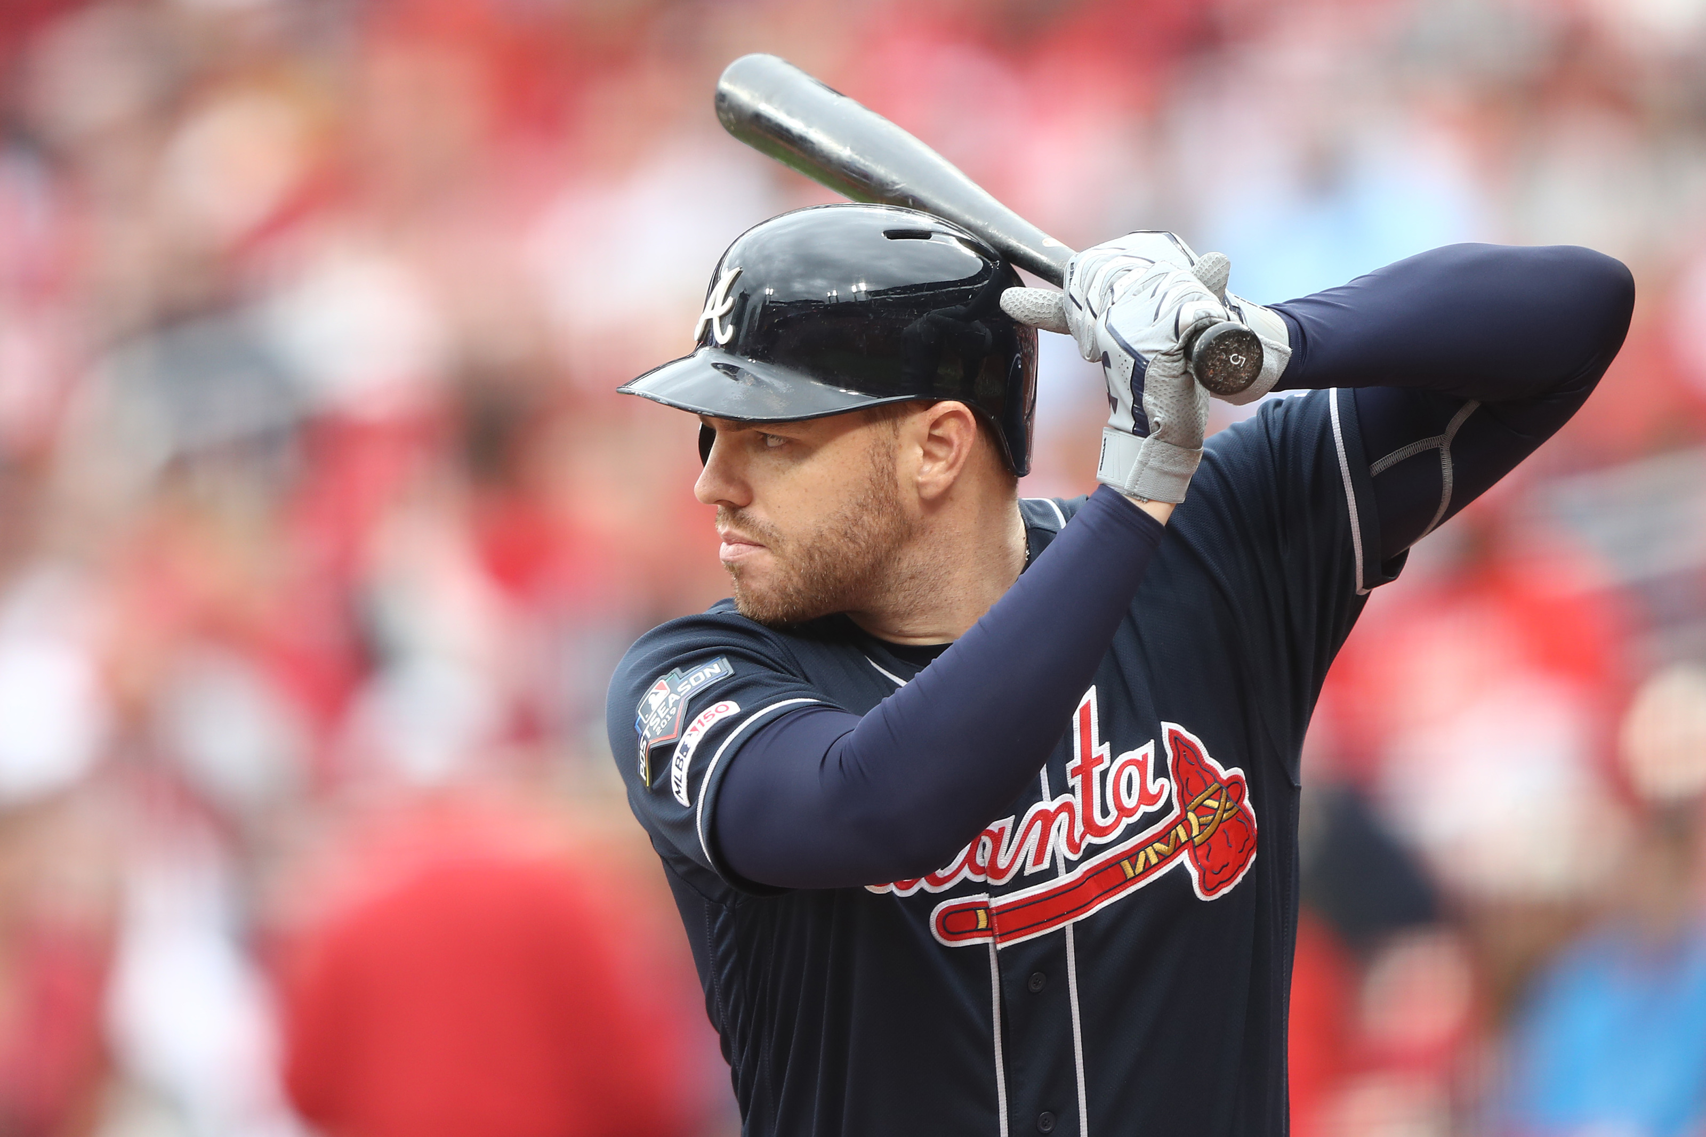
The Data (Exclusions)
The following data exclusions were utilized to achieve the model development dataset:
All pitchers (pitchers have at-bats in the National league, but their salary is virtually independent of their offensive performance).
Players with any features missing from the tables listed on the previous slide.
Players with a salary of $0 or $1 (very few observations).
Due to extreme collinearity, excluded all features with VIF > 20.
27 features had a Pearson r of at least 30% with the target AND a VIF less than 11.
Model development dataset: 974x28

Slide 12
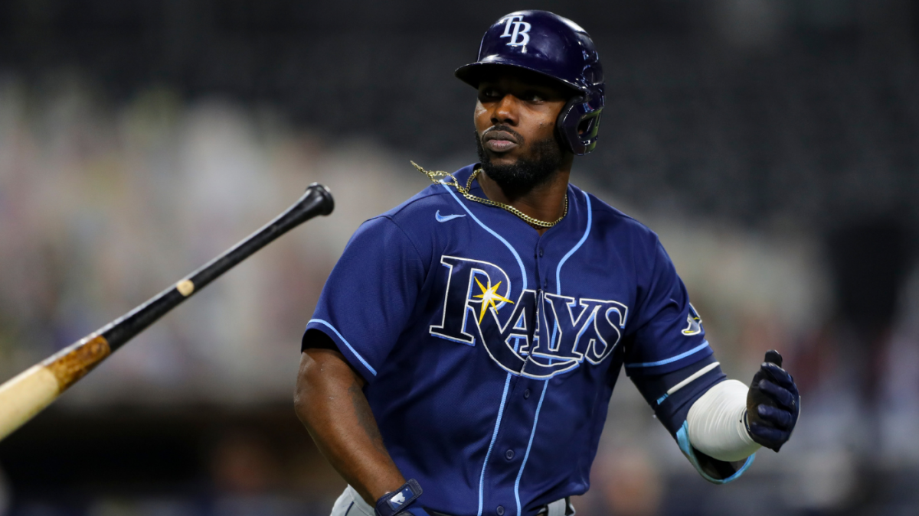
The Data (Transformations)
The following data transformations were applied to the model development dataset:
All features were z-transformed, but the target was not. I wanted to maintain the distribution of the target so we could see performance variation from different model types.
974 observations were randomly split into 70%/30% training/testing sets.
Training set: 675 players
Testing set: 299 players

Slide 13
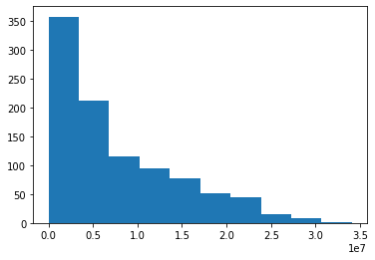
The Data (Exploration)
Salaries are heavily right-skewed and certainly not normally-distributed.
Therefore some types of regression (including OLS) might not work very well due to statistical assumptions on those types of models.
Nonetheless, the first type of model attempted is OLS Regression for simplicity.
This also opens the door for an easy benchmark that I can try to beat.
Salary:
Quantile | Value
0.01 | $509,610
0.10 | $567,000
0.25 | $2,100,000
0.50 | $5,250,000
0.75 | $11,875,000
0.90 | $18,500,000
0.99 | $26,000,000
Mean: | $7,688,531

Slide 14
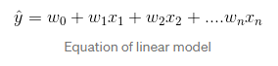
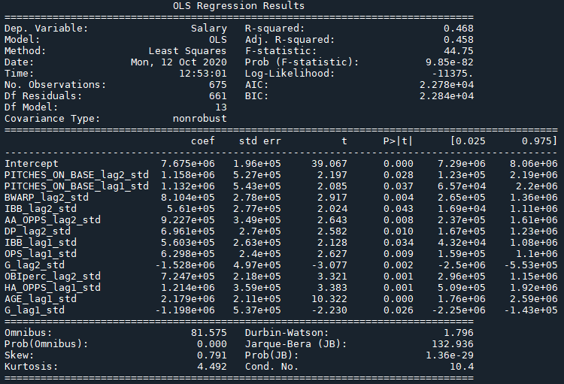
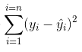
Model #1 – OLS Regression
Minimize:
import statsmodels.formula.api as smf
ols_results18 = smf.ols('Salary ~…’,data=baseball_train).fit()
In-Sample R-Squared: 46.8%
In-Sample RMSE: $5,042,075
OOS RMSE: $4,903,226
In-Sample SMAPE: 63.68%
OOS SMAPE: 52.13%

Slide 15
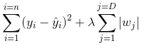
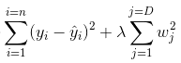
Model #2 – Lasso/Ridge
#a: LASSO;
from sklearn import linear_model
baseball_lasso = linear_model.Lasso(alpha=0.1)
baseball_lasso.fit(X,Y)
baseball_lasso.score(X,Y) #R2 = 48.03%
pred_lasso = baseball_lasso.predict(Xte)
y_preds['Lasso'] = pred_lasso
#b: RIDGE;
from sklearn.linear_model import Ridge
baseball_ridge = Ridge(alpha=1.0)
baseball_ridge.fit(X,Y)
baseball_ridge.score(X,Y) #R2 = 48.03% again
pred_ridge = baseball_ridge.predict(Xte)
y_preds['Ridge'] = pred_ridge
Minimize:
Lasso
Ridge
Lasso:
In-Sample R-Squared: 48.03%
OOS RMSE: $4,891,653
OOS SMAPE: 30.67%
Ridge:
In-Sample R-Squared: 48.03%
OOS RMSE: $4,891,157
OOS SMAPE: 30.69%

Slide 16
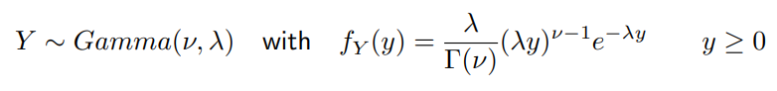
Model #3 – Gamma Regression
#c: GAMMA;
from sklearn.linear_model import GammaRegressor
baseball_gamma = GammaRegressor(alpha=1.0)
baseball_gamma.fit(X,Y)
baseball_gamma.score(X,Y) #D2 = 40.53%
pred_gamma = baseball_gamma.predict(Xte)
y_preds['Gamma'] = pred_gamma
Ridge:
OOS RMSE: $4,891,157
OOS SMAPE: 30.69%
Minimum Prediction: ($1,959,861)
Comments:
Preferred linear specification.
The log-link removes negative predictions, although we could override negative predictions to $500,000
Without any parameter tuning, SMAPE is the lowest of the group.
The model slightly overestimates which is conservative for the intended model purpose.
Gamma:
OOS RMSE: $5,125,900
OOS SMAPE: 30.27%
Minimum Prediction: $1,388,269

Slide 17
Gamma Predictions vs. Ridge (OOS)

Slide 18
Model Comparison and Results
I added an SGD and Perceptron model for fun, because they are easy to do in SkLearn.
Gamma Regression was chosen as the “best” model due to best OOS predictions and most appropriate methodology given the data. Ridge is close but still produces negative predicted values.

Slide 19
Where Are They Now??
Cespedes – was indeed overpaid. Signed a huge contract, injured multiple times, out of the MLB.
Pujols – was overpaid in 2019. 3rd oldest player in the AL, batted .244 in 2019.
Heyward - certainly overpaid in ‘16, batted .230 after signing big contract.
Ellsbury – “The 2016 season was another underwhelming one for Ellsbury offensively, as he hit .263/.330/.374 with 9 home runs and 20 stolen bases, the latter being his lowest in a healthy season” – wiki.
Upton – Hit .246 with 31 HRs in ‘16, was an all-star in ‘17. Model missed this one.
Martinez – Best hitter in the AL in 2018 – big miss!
BUT – this model is intended to identify value “under the radar” – let’s see how we did on underpaid players.

Slide 20
Where Are They Now??
Goldschmidt – was an all-star in 3 consecutive years (15-17) and NL MVP runner-up. Hit for the model.
Markakis – hit .285, 9 HR, 62 RBI in 2019. Perfect “Moneyball” example – cheap veteran.
Votto – was an all-star in 2018, led the NL in OBP.
Trout – the LeBron James of baseball. Had already won 2 NL MVP awards by 2016.
Bautista – 7-year low in OPS in 2016, but above average. Reasonable prediction of value.
Byrd – very underpaid in 2015. In 34 games, he hit .270 with 5 HR and 19 RBI. PED suspension followed ☹
Rollins – career low AVG in 2015, then benched. Model missed this one.
Granderson – Marlins took a shot but he hit career low .183. Maybe their model identified him??
Carpenter – was an all-star in 2016, led the NL in first-half OPS (over 1.00).
Lind – Nats took a shot with a 1-year deal. Lind batted .303 with 14 home runs and 59 RBIs while appearing in 116 games. Classic moneyball veteran.

Slide 21
What Went Well? What Didn’t?
Model appears to successfully identify undervalued players, which is pretty cool.
The fit and prediction quality are pretty good considering the development set has less than 1,000 rows.
With that being said, I would love to construct a larger dataset. Would probably take some simple web scraping code.
Gamma regression works fairly well, but there are clearly nonlinear relationships that I’ve missed. A nonlinear regression or neural network would predict much more accurately. At the very least I could apply Weight of Evidence transformation to inputs.
Many features were spoiled right away due to extreme collinearity. Could find more diverse advanced statistics from multiple websites or add interaction terms.
Overall I’m satisfied with this project, and it was a blast to put it together.

Slide 22
Questions & Contact Info
Thank you for this opportunity! Please feel free to contact me:
alexmartishius@gmail.com

